Slide 1
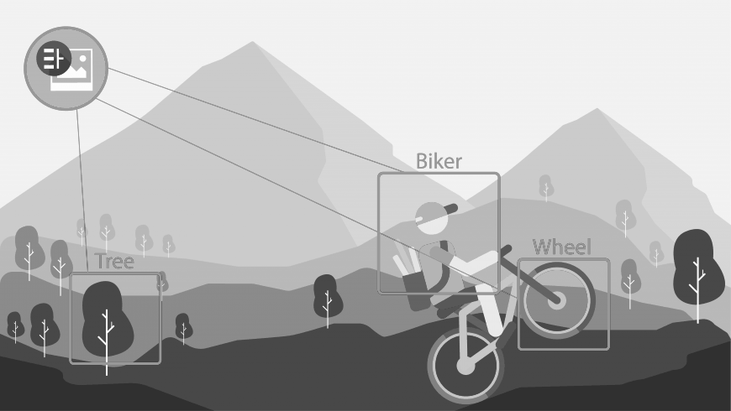
IBM Watson Visual Recognition API by Isaac Ramírez Herrera

Slide 2
What is it about?
The IBM Watson™ Visual Recognition service uses deep learning algorithms to analyze images for scenes, objects, faces, and other content. The response includes keywords that provide information about the content.

Slide 3
How to use it

Slide 4
Use cases
The Visual Recognition service can be used for diverse applications and industries, such as:
Manufacturing: Use images from a manufacturing setting to make sure products are being positioned correctly on an assembly line
Visual auditing: Look for visual compliance or deterioration in a fleet of trucks, planes, or windmills out in the field, train custom models to understand what defects look like
Insurance: Rapidly process claims by using images to classify claims into different categories
Social listening: Use images from your product line or your logo to track buzz about your company on social media
Social commerce: Use an image of a plated dish to find out which restaurant serves it and find reviews, use a travel photo to find vacation suggestions based on similar experiences
Retail: Take a photo of a favorite outfit to find stores with those clothes in stock or on sale, use a travel image to find retail suggestions in that area
Education: Create image-based applications to educate about taxonomies

Slide 5
What are we going to do?
Configure the IBM Watson Visual Recognition service in IBM Cloud
Use the Java SDK to train the API to recognize images
Create a simple CLI application to execute these tasks.

Slide 6
Service configuration
Go to https://console.bluemix.net/catalog/services/visual-recognition
Create the service
Retrieve the credentials
Make sure it is properly set by testing it using Postman
https://watson-visual-recognition.ng.bluemix.net/ can be use to iteract with the service.

Slide 9
Using the service in Java
Go to Eclipse and create a new Java project
Create a new lib folder to store the dependencies

Slide 10
Using the service in Java
Download the Watson SDK and all its dependencies:
Go to https://jar-download.com/online-maven-download-tool.php
Paste the maven xml:
<dependency>
<groupId>com.ibm.watson.developer_cloud</groupId>
<artifactId>visual-recognition</artifactId>
<version>6.5.1</version>
</dependency>
Hit submit.

Slide 11
Using the service in Java
Unzip the file
Copy the dependencies to the lib folder
Add them to the build path

Slide 12
We are ready to code!

